Slide 1
Randomized Algorithms CS648
Lecture 2
Three interesting problems
Randomized Quick Sort
Balls into bins
Balls out of bin
Random Variable and Expected value

Slide 2

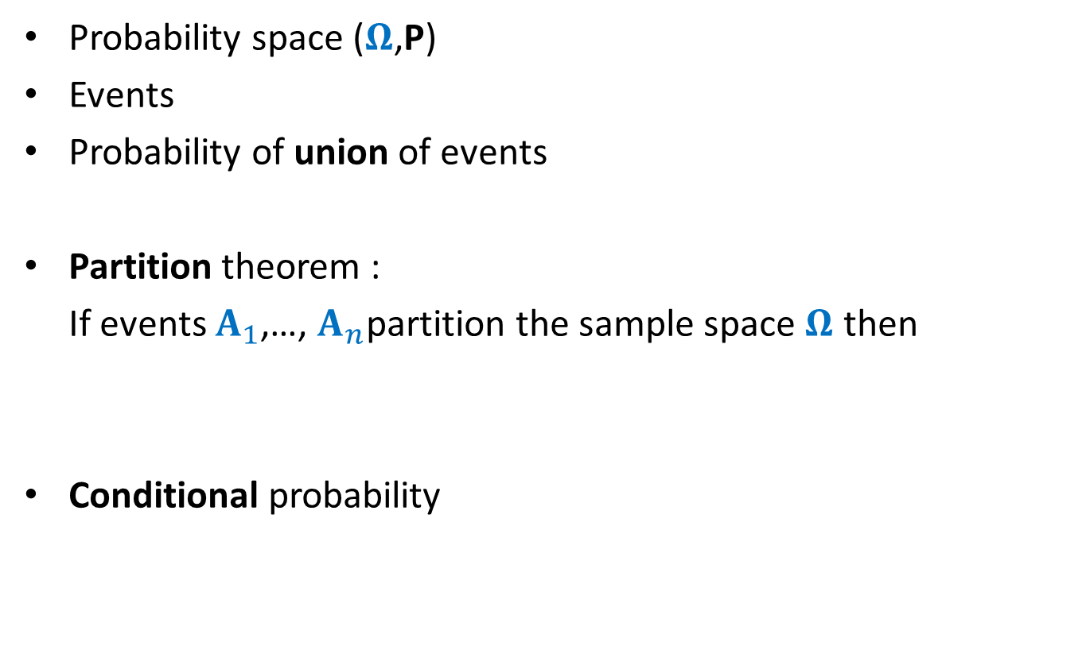
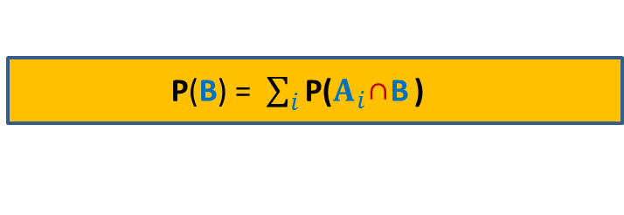

Recap from Optional lecture
Probability space ($Ω$,P)
Events
Probability of union of events
Partition theorem :
If events $A_{1}$,…, $A_{n}$partition the sample space $Ω$ then
Conditional probability
P(AUB) = P(A) + P(B) $−$ P(A∩B)
P(B) = $\sum_{i}{\text{P}\text{(}A_{i}\text{∩}\text{B}}$ )
P[A|B] = $\frac{P[A∩B]}{P[B]}$
CS203B: Mathematics for Computer Science – III
Tuesday, Wednesday, Friday : RM101

Slide 3
Randomized Quick sort

Slide 4
How to solve a problem ?

Slide 5
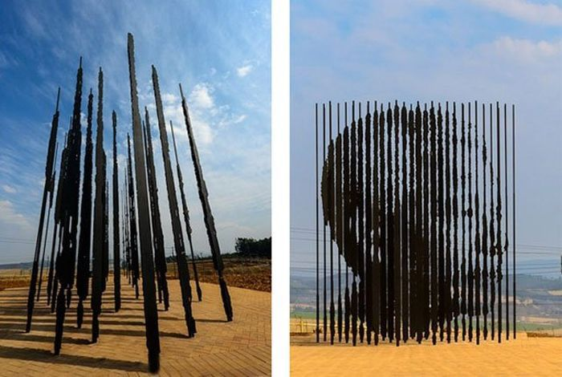

Perspective
does matter

Slide 6
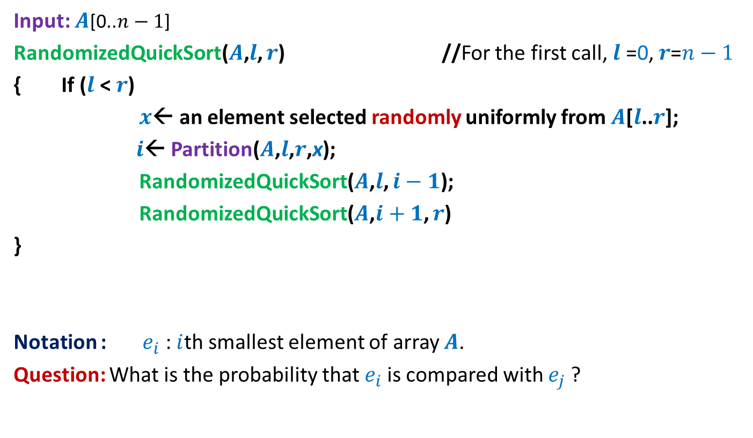
Randomized Quick Sort
Input: $A$[0..$n−1$]
RandomizedQuickSort($A$,$l$, $r$) //For the first call, $l$ =0, $r$=$n−1$
{ If ($l$ < $r$)
$x$← an element selected randomly uniformly from $A$[$l$..$r$];
$i$← Partition($A$,$l$,$r$,x);
RandomizedQuickSort($A$,$l$, $i−1$);
RandomizedQuickSort($A$,$i+1$, $r$)
}
Notation : $e_{i}$ : $i$th smallest element of array $A$.
Question: What is the probability that $e_{i}$is compared with $e_{j}$?

Slide 7

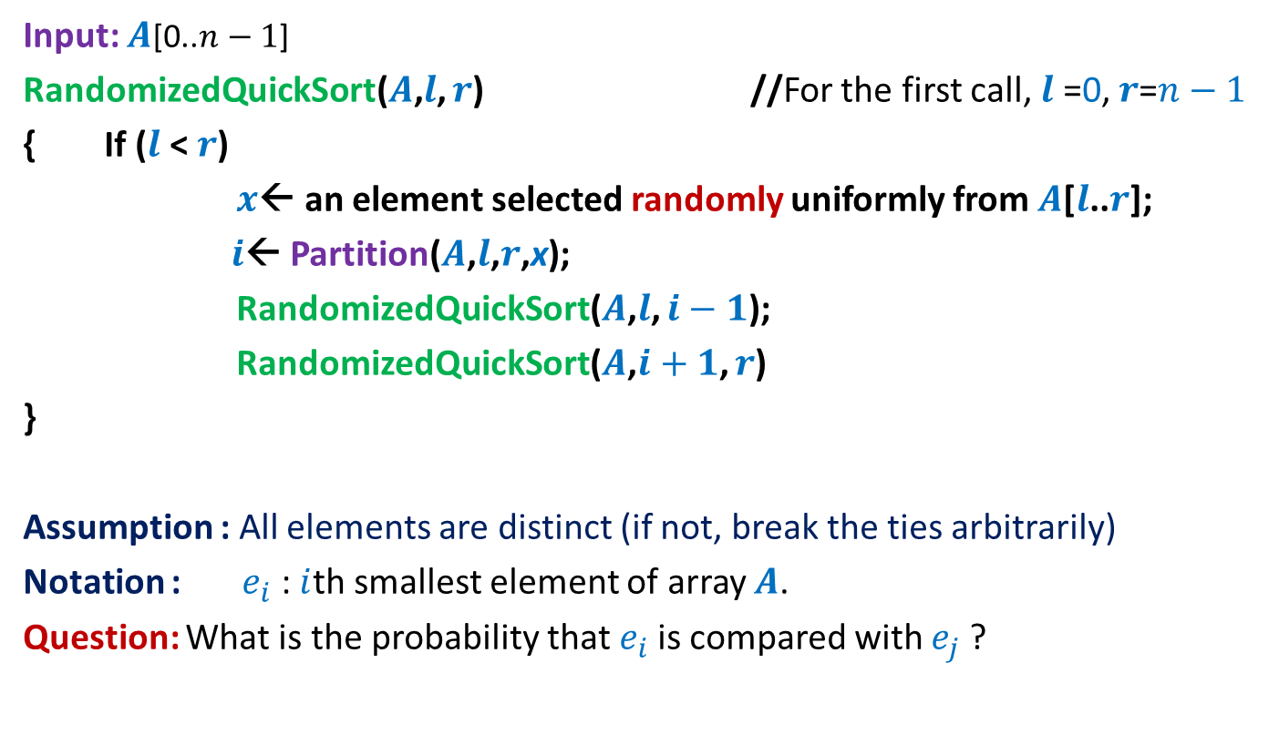
Randomized Quick Sort
Input: $A$[0..$n−1$]
RandomizedQuickSort($A$,$l$, $r$) //For the first call, $l$ =0, $r$=$n−1$
{ If ($l$ < $r$)
$x$← an element selected randomly uniformly from $A$[$l$..$r$];
$i$← Partition($A$,$l$,$r$,x);
RandomizedQuickSort($A$,$l$, $i−1$);
RandomizedQuickSort($A$,$i+1$, $r$)
}
Assumption : All elements are distinct (if not, break the ties arbitrarily)
Notation : $e_{i}$ : $i$th smallest element of array $A$.
Question: What is the probability that $e_{i}$is compared with $e_{j}$?
Recall that the execution of RandomizedQuickSort is totally immune to the permutation of $A$.

Slide 8
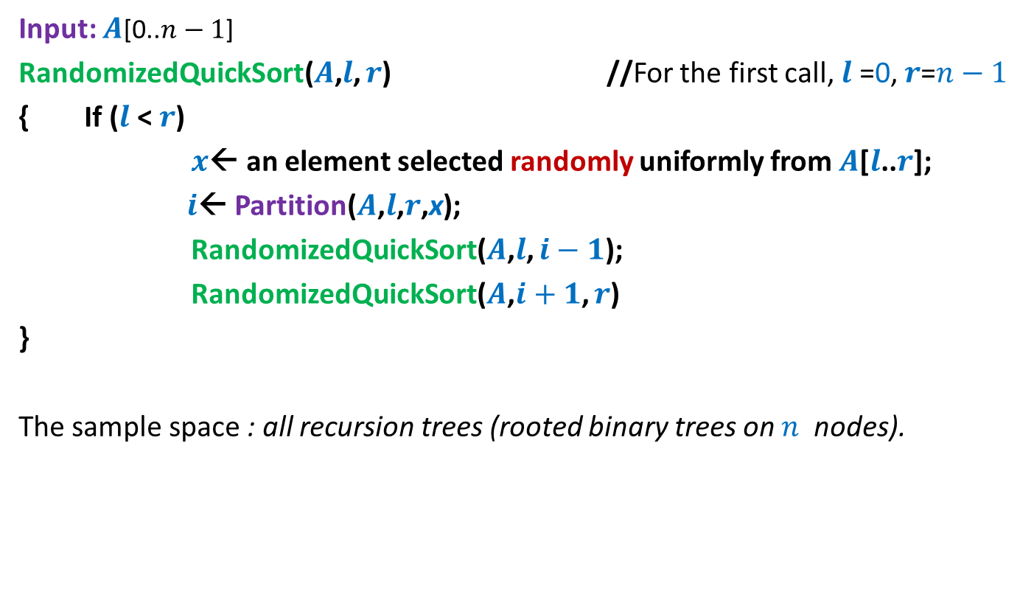
Randomized Quick Sort
Input: $A$[0..$n−1$]
RandomizedQuickSort($A$,$l$, $r$) //For the first call, $l$ =0, $r$=$n−1$
{ If ($l$ < $r$)
$x$← an element selected randomly uniformly from $A$[$l$..$r$];
$i$← Partition($A$,$l$,$r$,x);
RandomizedQuickSort($A$,$l$, $i−1$);
RandomizedQuickSort($A$,$i+1$, $r$)
}
The sample space : all recursion trees (rooted binary trees on $n$ nodes).

Slide 9



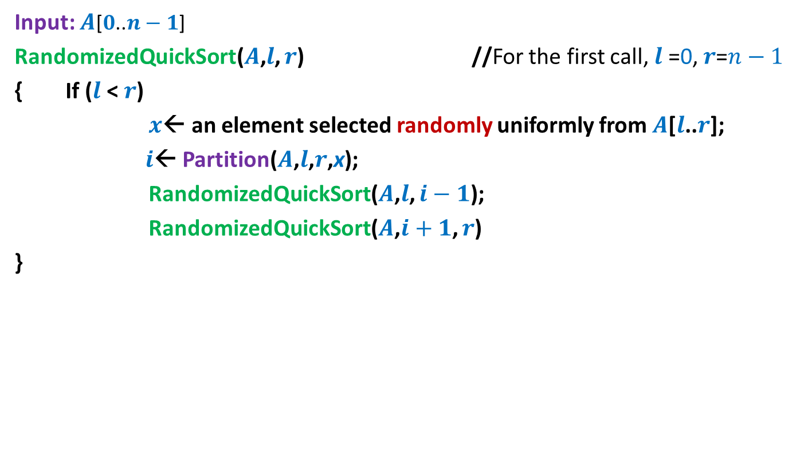

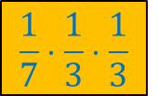




Randomized Quick Sort
Input: $A$[$0$..$n−1$]
RandomizedQuickSort($A$,$l$, $r$) //For the first call, $l$ =0, $r$=$n−1$
{ If ($l$ < $r$)
$x$← an element selected randomly uniformly from $A$[$l$..$r$];
$i$← Partition($A$,$l$,$r$,x);
RandomizedQuickSort($A$,$l$, $i−1$);
RandomizedQuickSort($A$,$i+1$, $r$)
}
$$n=7$$
$$\frac{1}{7}⋅\frac{1}{3}⋅\frac{1}{3}$$
$$e_{4}$$
$$e_{2}$$
$$e_{6}$$
$$e_{1}$$
$$e_{3}$$
$$e_{5}$$
$$e_{7}$$

Slide 10




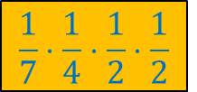




Randomized Quick Sort
Input: $A$[$0$..$n−1$]
RandomizedQuickSort($A$,$l$, $r$) //For the first call, $l$ =0, $r$=$n−1$
{ If ($l$ < $r$)
$x$← an element selected randomly uniformly from $A$[$l$..$r$];
$i$← Partition($A$,$l$,$r$,x);
RandomizedQuickSort($A$,$l$, $i−1$);
RandomizedQuickSort($A$,$i+1$, $r$)
}
$$n=7$$
$$e_{5}$$
$$\frac{1}{7}⋅\frac{1}{4}⋅\frac{1}{2}⋅\frac{1}{2}$$
$$e_{2}$$
$$e_{6}$$
$$e_{1}$$
$$e_{4}$$
$$e_{7}$$
$$e_{3}$$

Slide 11
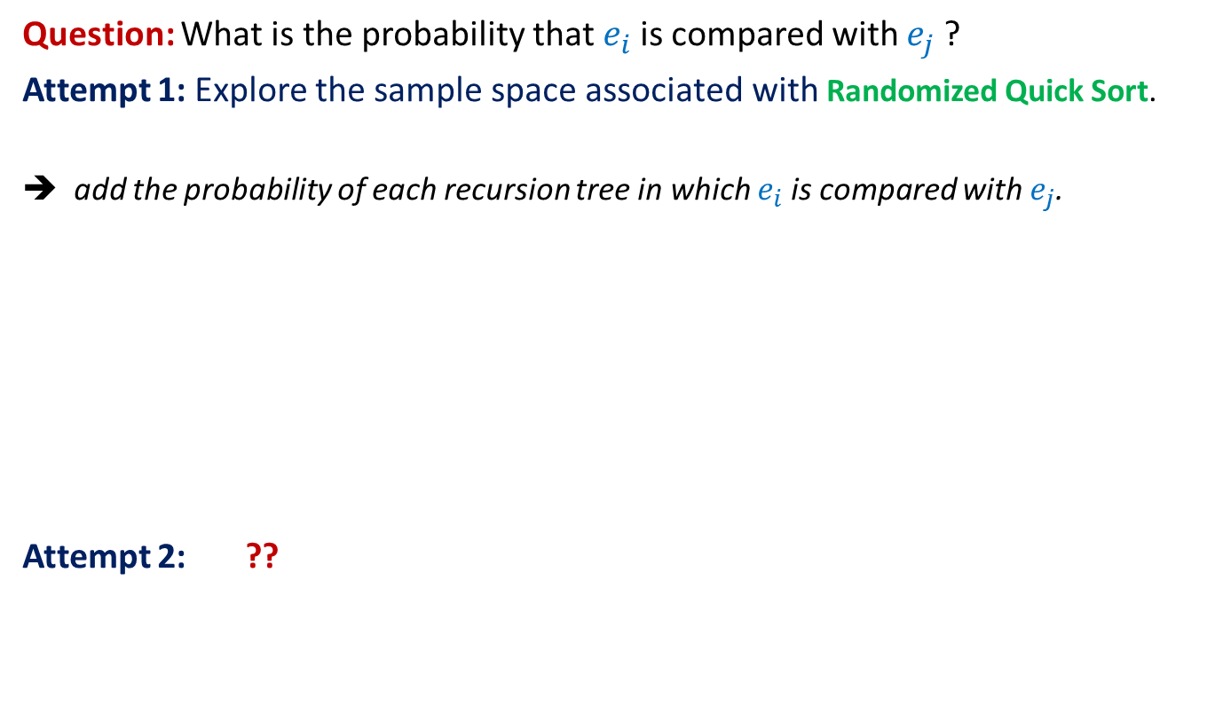
Randomized Quick Sort
Question: What is the probability that $e_{i}$is compared with $e_{j}$?
Attempt 1: Explore the sample space associated with Randomized Quick Sort.
➔ add the probability of each recursion tree in which $e_{i}$is compared with $e_{j}$.
Attempt 2: ??
Not a feasible way to calculate the probability
View the execution of RandomizedQuickSort from perspective of $e_{i}$ and $e_{j}$

Slide 12
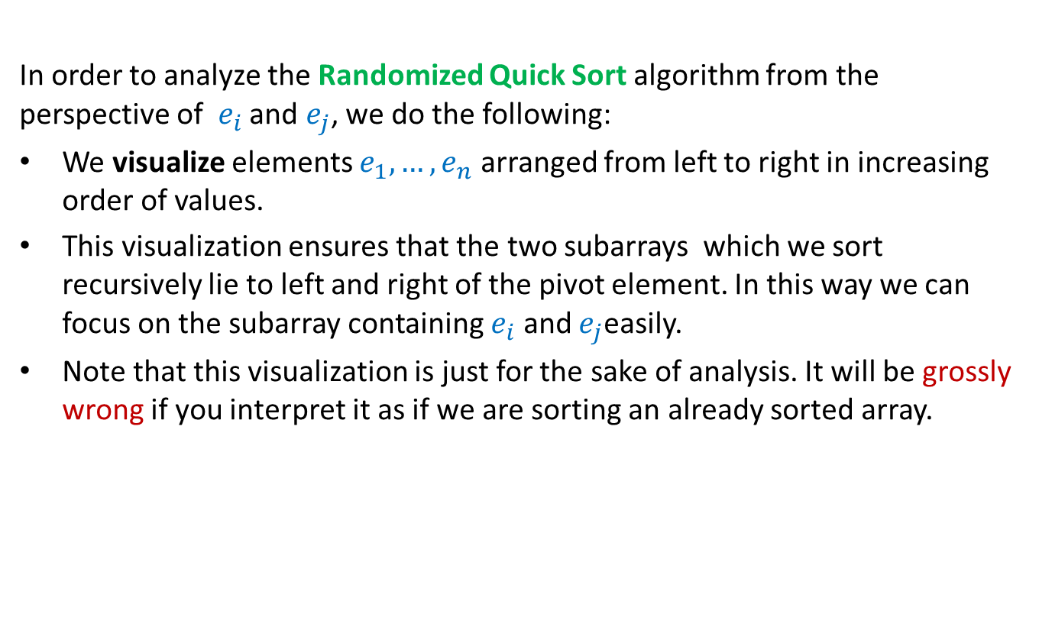

Randomized Quick Sort from perspective of $e_{i}$and $e_{j}$
In order to analyze the Randomized Quick Sort algorithm from the perspective of $e_{i}$ and $e_{j}$, we do the following:
We visualize elements $e_{1}, …, e_{n}$ arranged from left to right in increasing order of values.
This visualization ensures that the two subarrays which we sort recursively lie to left and right of the pivot element. In this way we can focus on the subarray containing $e_{i}$ and $e_{j}$easily.
Note that this visualization is just for the sake of analysis. It will be grossly wrong if you interpret it as if we are sorting an already sorted array.
Go through the next few slides slowly and patiently, pondering at each step. Never accept anything until and unless you can see the underlying truth yourself.

Slide 13




Randomized Quick Sort from perspective of $e_{i}$and $e_{j}$
Elements of A arranged in Increasing order of values
$$e_{i}$$
$$e_{j}$$
What did you observe ?
$e_{i}$ and $e_{j}$ continue to
remain “together” in the recursive calls
as long as …
the pivot element is not picked
from $e_{i},…,e_{j}$.

Slide 14







Randomized Quick Sort from perspective of $e_{i}$and $e_{j}$
$$e_{i}$$
$$e_{j}$$
Observation 1:
$e_{i}$and $e_{j}$get compared during an instance of Randomized Quick Sort iff
the first pivot element from $S_{ij}$is either $e_{i}$or $e_{j}$.
$$S_{ij}$$
$e_{i}$and $e_{j}$ be compared
No influence
$e_{i}$and $e_{j}$ be compared
$e_{i}$and $e_{j}$ will not be compared
No influence
Take a closer look on the sequence of pivot elements to find their influence on “the possibility” of comparison between $e_{i}$and $e_{j}$ .
To determine the probability of this event, let us have a look at Randomized Quick Sort from perspective of $S_{ij}$.

Slide 15

Randomized Quick Sort from perspective of $e_{i}$and $e_{j}$
$$e_{i}$$
$$e_{j}$$
Each element is equally likely to be the pivot element in this recursive call.
Observation 2: During Randomized Quick Sort, each element from the set $S_{ij}$
is equally likely to be picked as the first pivot element among $S_{ij}$.
Each element is equally likely to be the pivot element in this recursive call.
Each element is equally likely to be the pivot element in this recursive call.
Each element is equally likely to be the pivot element in this recursive call.
Each element is equally likely to be the pivot element in this recursive call.

Slide 16
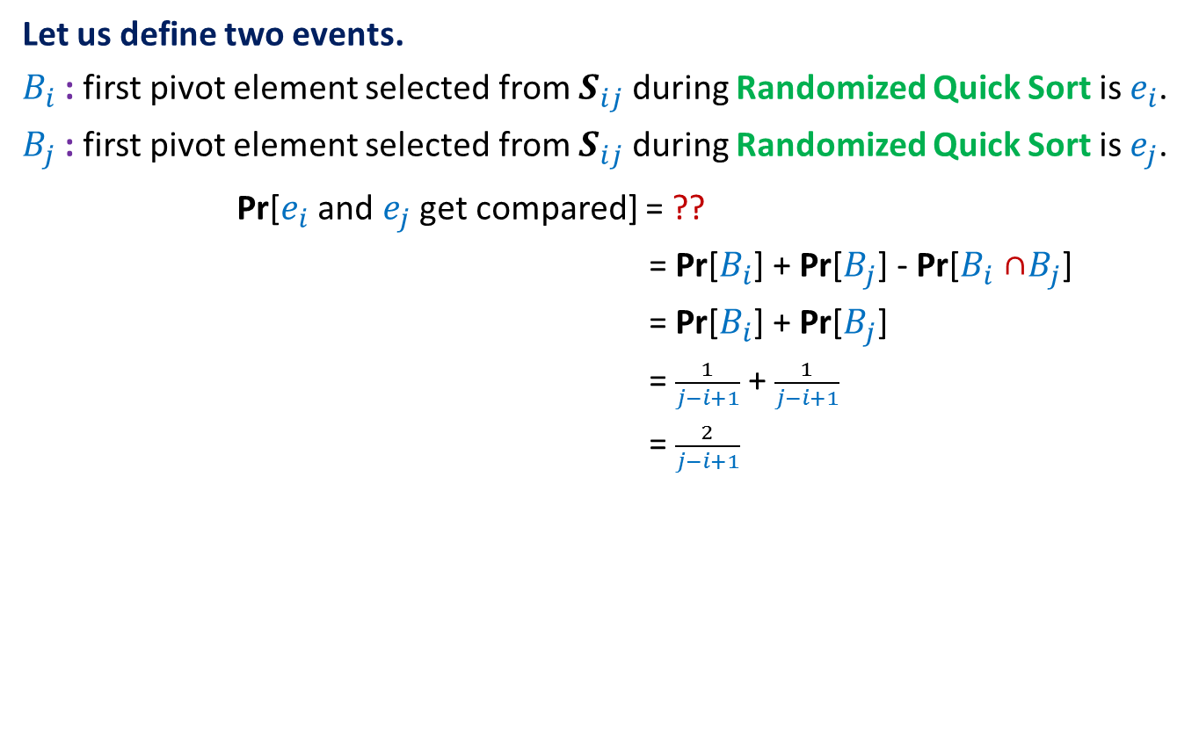

Randomized Quick Sort from perspective of $e_{i}$and $e_{j}$
Let us define two events.
$B_{i}$ : first pivot element selected from $S_{ij}$ during Randomized Quick Sort is $e_{i}$.
$B_{j}$ : first pivot element selected from $S_{ij}$ during Randomized Quick Sort is $e_{j}$.
Pr[$e_{i}$and $e_{j}$get compared] = ??
= Pr[$B_{i}$] + Pr[$B_{j}$] - Pr[$B_{i}$ ∩$B_{j}$]
= Pr[$B_{i}$] + Pr[$B_{j}$]
= $\frac{1}{j−i+1}$+ $\frac{1}{j−i+1}$
= $\frac{2}{j−i+1}$
Pr[$B_{i}$U$B_{j}$]
use Observation 2

Slide 17




Randomized Quick Sort from perspective of $e_{i}$and $e_{j}$
Let us define two events.
$B_{i}$ : first pivot element selected from $S_{ij}$ during Randomized Quick Sort is $e_{i}$.
$B_{j}$ : first pivot element selected from $S_{ij}$ during Randomized Quick Sort is $e_{j}$.
Pr[$e_{i}$and $e_{j}$get compared] = ??
= Pr[$B_{i}$] + Pr[$B_{j}$] - Pr[$B_{i}$ ∩$B_{j}$]
= Pr[$B_{i}$] + Pr[$B_{j}$]
= $\frac{1}{j−i+1}$+ $\frac{1}{j−i+1}$
= $\frac{2}{j−i+1}$
Pr[$B_{i}$U$B_{j}$]
What relation exists between $B_{i}$ and $B_{j}$ ?
Pr[$B_{i}$] = $\frac{1}{|S_{ij}|}$ using Observation 2
What is Pr[$B_{i}$] ?
$B_{i}$ and $B_{j}$are disjoint events.

Slide 18





Randomized Quick Sort from perspective of $e_{i}$and $e_{j}$
$$e_{i}$$
$$e_{j}$$
Pr[$e_{i}$and $e_{j}$get compared] = Pr[$B_{i}$U$B_{j}$]
= Pr[$B_{i}$] + Pr[$B_{j}$] - Pr[$B_{i}$ ∩$B_{j}$]
= Pr[$B_{i}$] + Pr[$B_{j}$]
= $\frac{1}{j−i+1}$+ $\frac{1}{j−i+1}$
= $\frac{2}{j−i+1}$
$$S_{ij}$$
What relation exists between $B_{i}$ and $B_{j}$ ?
Pr[$B_{i}$] = $\frac{1}{|S_{ij}|}$.
What is Pr[$B_{i}$] ?
$B_{i}$ and $B_{j}$are disjoint events.

Slide 19
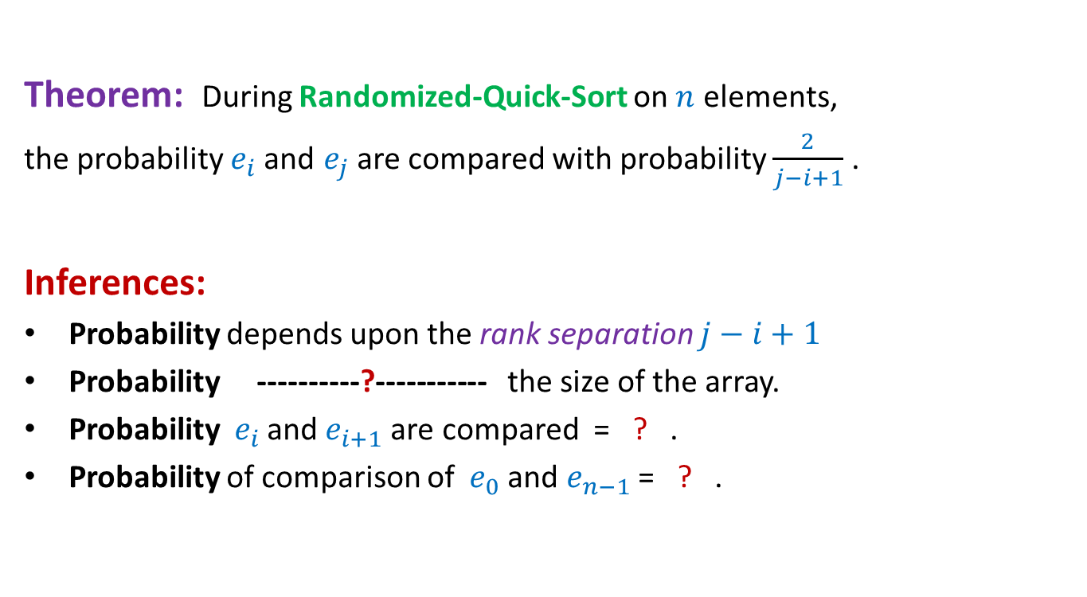


Randomized Quick Sort from perspective of $e_{i}$and $e_{j}$
Theorem: During Randomized-Quick-Sort on $n$ elements,
the probability $e_{i}$and $e_{j}$ are compared with probability $\frac{2}{j−i+1}$ .
Inferences:
Probability depends upon the rank separation $j−i+1$
Probability ----------?----------- the size of the array.
Probability ${ e}_{i}$and $e_{i+1}$are compared = ? .
Probability of comparison of ${ e}_{0}$and $e_{n−1}$= ? .
is independent of
$$1$$
$$\frac{2}{n}$$

Slide 20
Balls into BINS

Slide 21
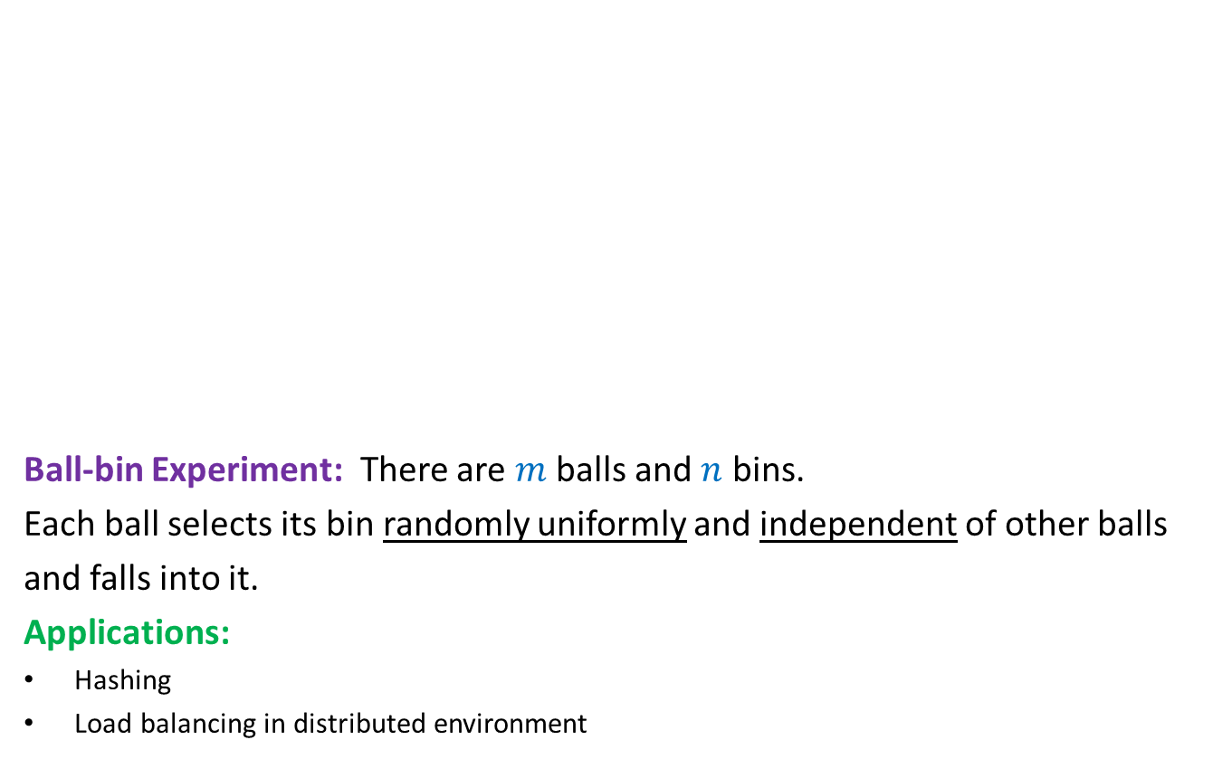
Balls into Bins
1 2 3 4 5 … $m−1$ $m$
Ball-bin Experiment: There are $m$ balls and $n$ bins.
Each ball selects its bin randomly uniformly and independent of other balls
and falls into it.
Applications:
Hashing
Load balancing in distributed environment
1 2 3 … $i$ … $n$

Slide 22
Balls into Bins
1 2 3 4 5 … $m−1 m$
Question : What is the probability that there is at least one empty bin ?
1 2 3 … $i$ … $n$

Slide 23
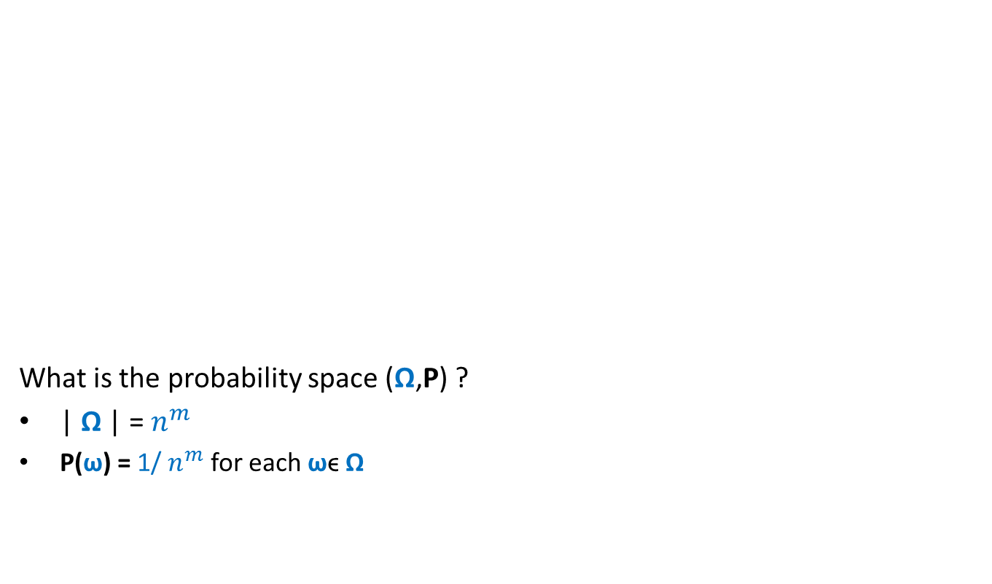
Balls into Bins
1 2 3 4 5 … $m−1 m$
What is the probability space (Ω,P) ?
| Ω | = $n^{m}$
P(ω) = 1/ $n^{m}$ for each ωϵ Ω
1 2 3 … $i$ … $n$

Slide 24
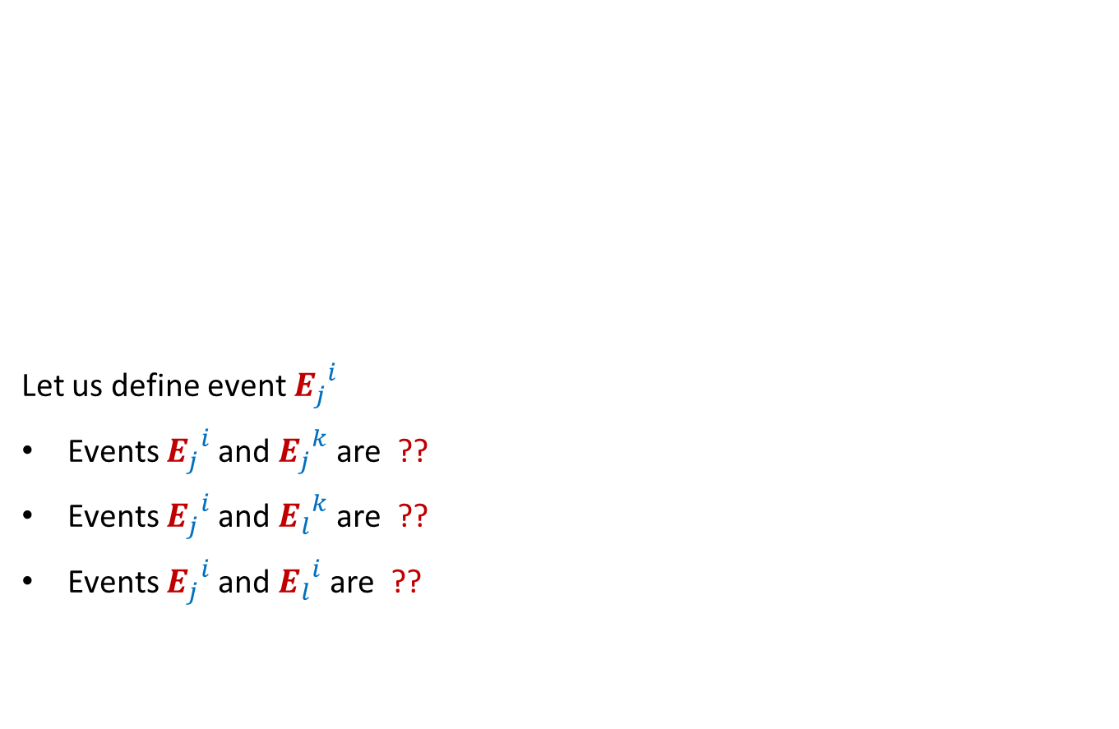

Balls into Bins
1 2 3 4 5 … $j$ … $m−1 m$
Let us define event ${E_{j}}_{}^{i}$
Events ${E_{j}}_{}^{i}$and ${E_{j}}_{}^{k}$are ??
Events ${E_{j}}_{}^{i}$and ${E_{l}}_{}^{k}$are ??
Events ${E_{j}}_{}^{i}$and ${E_{l}}_{}^{i}$are ??
1 2 3 … $i$ … $n$
: $j$th ball falls into $i$th bin.
disjoint
Independent
Independent

Slide 25

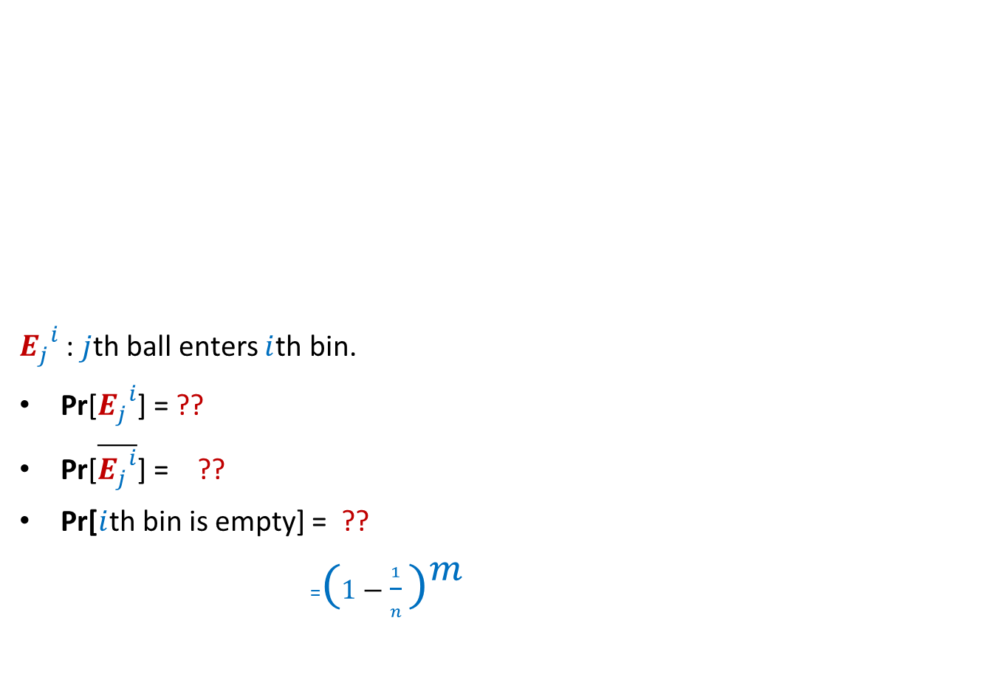
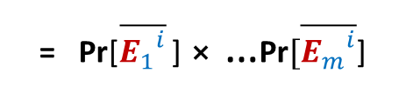
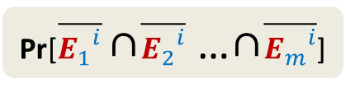

Balls into Bins
1 2 3 4 5 … $j$ … $m−1 m$
${E_{j}}_{}^{i}$ : $j$th ball enters $i$th bin.
Pr[${E_{j}}_{}^{i}$] = ??
Pr[$\overline{{E_{j}}_{}^{i}}$] = ??
Pr[$i$th bin is empty] = ??
=${(1−\frac{1}{n} )}^{m}$
1 2 3 … $i$ … $n$
$$\frac{1}{n}$$
$$1−\frac{1}{n}$$
Pr[$\overline{{E_{1}}_{}^{i}}$ ∩$\overline{{E_{2}}_{}^{i}}$ …∩$\overline{{E_{m}}_{}^{i}}$]
= Pr[$\overline{{E_{1}}_{}^{i}}$ ] ⨯ …$\text{Pr}[\overline{{E_{m}}_{}^{i}}$]

Slide 26



Balls into Bins
1 2 3 4 5 … $j$ … $m−1 m$
Pr[$i$th bin is empty] = ${(1−\frac{1}{n} )}^{m}$
Pr[$i$th and $k$th bin are empty] = ??
Pr[a specified set of $l$bins are empty] = ??
1 2 3 … $i$ … $n$
$${(1−\frac{2}{n} )}^{m}$$
$${(1−\frac{l}{n} )}^{m}$$

Slide 27
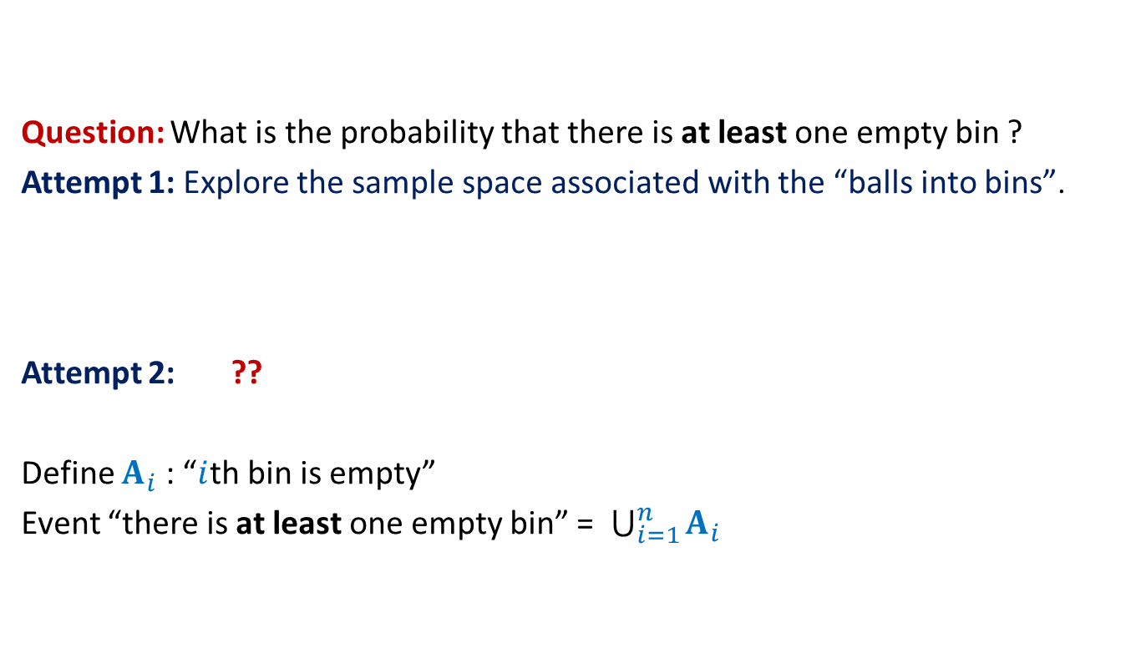
Balls into Bins
Question: What is the probability that there is at least one empty bin ?
Attempt 1: Explore the sample space associated with the “balls into bins”.
Attempt 2: ??
Define $A_{i}$ : “$i$th bin is empty”
Event “there is at least one empty bin” = $\bigcup_{i=1}^{n}{A_{i}}$
Express the event as union of some events …

Slide 28

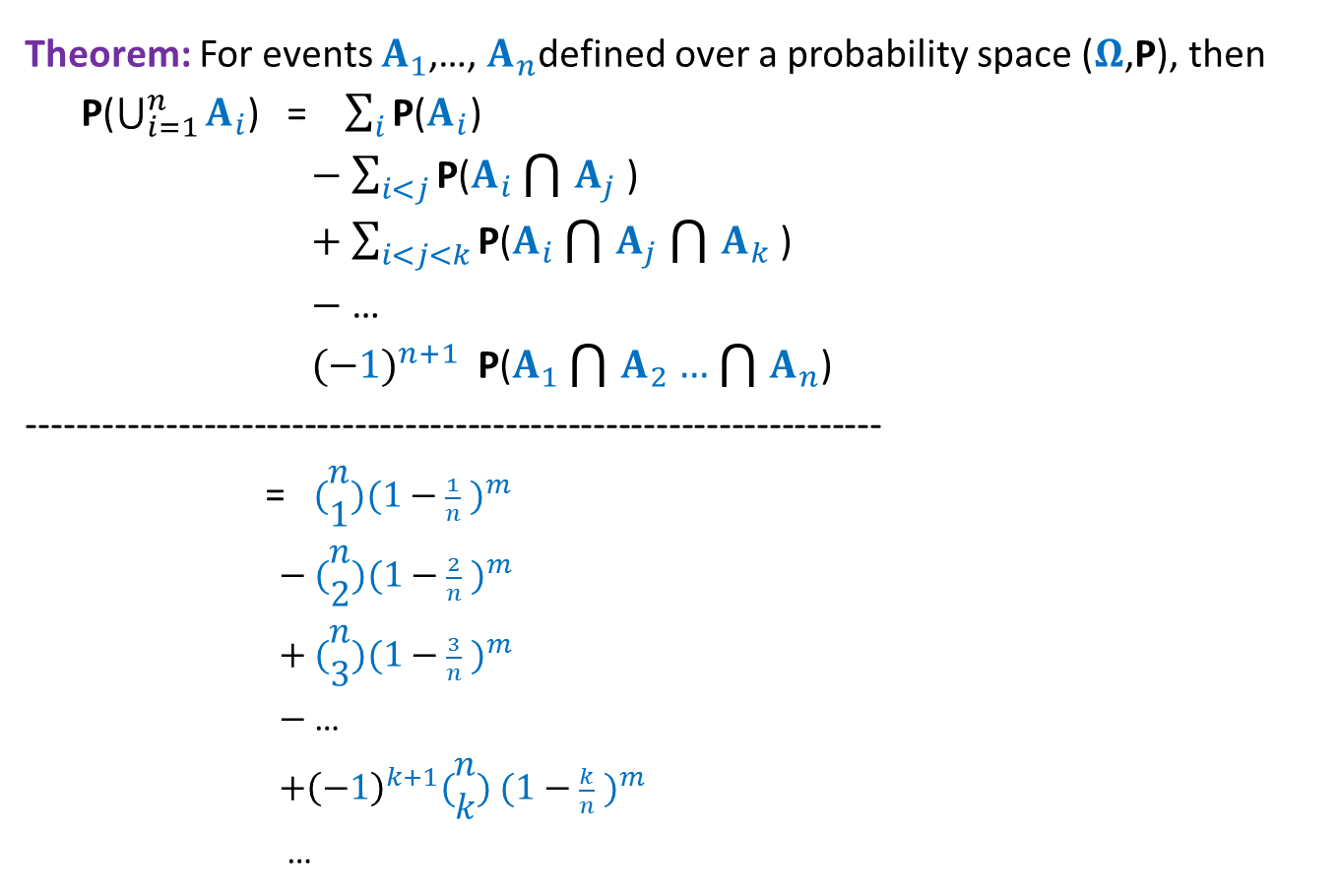
Balls into Bins
Theorem: For events $A_{1}$,…, $A_{n}$defined over a probability space ($Ω$,P), then
P($\bigcup_{i=1}^{n}{A_{i}}$) = $\sum_{i}{\text{P}\text{(}A_{i}\text{)}}$
$−$ $\sum_{i<j}{\text{P}\text{(}A_{i}\bigcap{A_{j}}\text{)}}$
$+$ $\sum_{i<j<k}{\text{P}\text{(}A_{i}\bigcap{A_{j}}\bigcap{A_{k}}\text{)}}$
$−$ …
${(−1)}^{n+1}$ $\text{P}\text{(}A_{1}\bigcap{A_{2}}…\bigcap{A_{n}}$)
--------------------------------------------------------------------
= $(\begin{matrix}n \\ 1\end{matrix}){(1−\frac{1}{n} )}^{m}$
$−$ $(\begin{matrix}n \\ 2\end{matrix}){(1−\frac{2}{n} )}^{m}$
$+$ $(\begin{matrix}n \\ 3\end{matrix}){(1−\frac{3}{n} )}^{m}$
$−$ …
${+\left(−1\right)}^{k+1}(\begin{matrix}n \\ k\end{matrix})$ ${(1−\frac{k}{n} )}^{m}$
…
$$p(n,m)$$

Slide 29

Balls into Bins
Homework Exercise:
What is the probability that there are exactly $k$empty bins ?
Hint: You will need to use $p(n,m)$ with suitable values of $n$.

Slide 30
Balls Out of BIN

Slide 31


Balls Out of Bin
There is a bin containing $r$ red balls and $b$ blue balls.
Balls are taken out from the bag
Question: What is the probability that appears ahead of all blue balls. ?
uniformly randomly
and without replacement.
What if $r$ = 1 ?

Slide 32
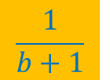
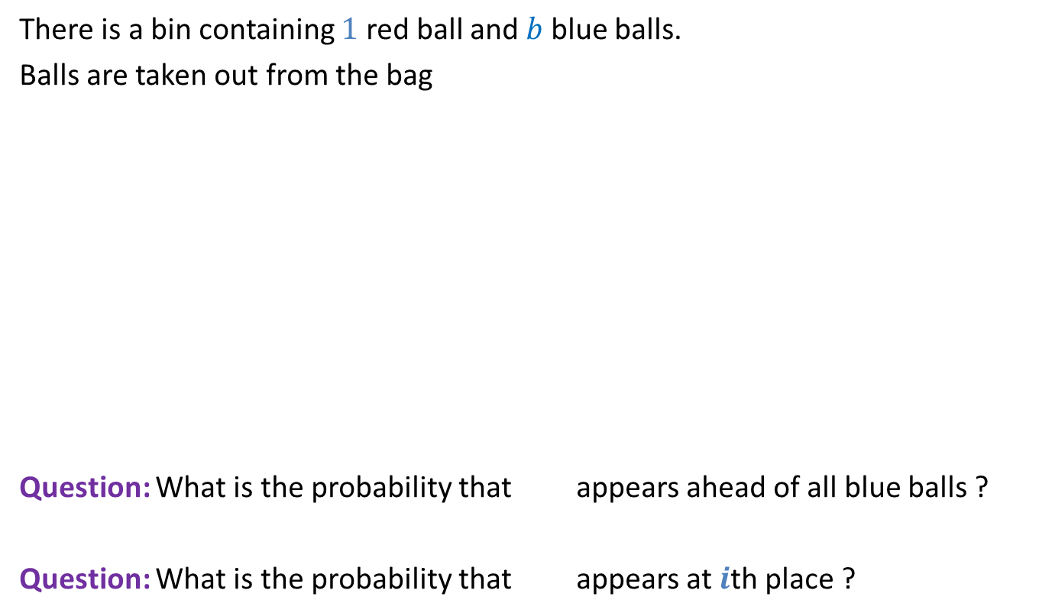
Balls Out of Bin
There is a bin containing $1$ red ball and $b$ blue balls.
Balls are taken out from the bag
Question: What is the probability that appears ahead of all blue balls ?
Question: What is the probability that appears at $i$th place ?
uniformly randomly
and without replacement.
$$\frac{1}{b+1}$$
$$\frac{1}{b+1}$$

Slide 33
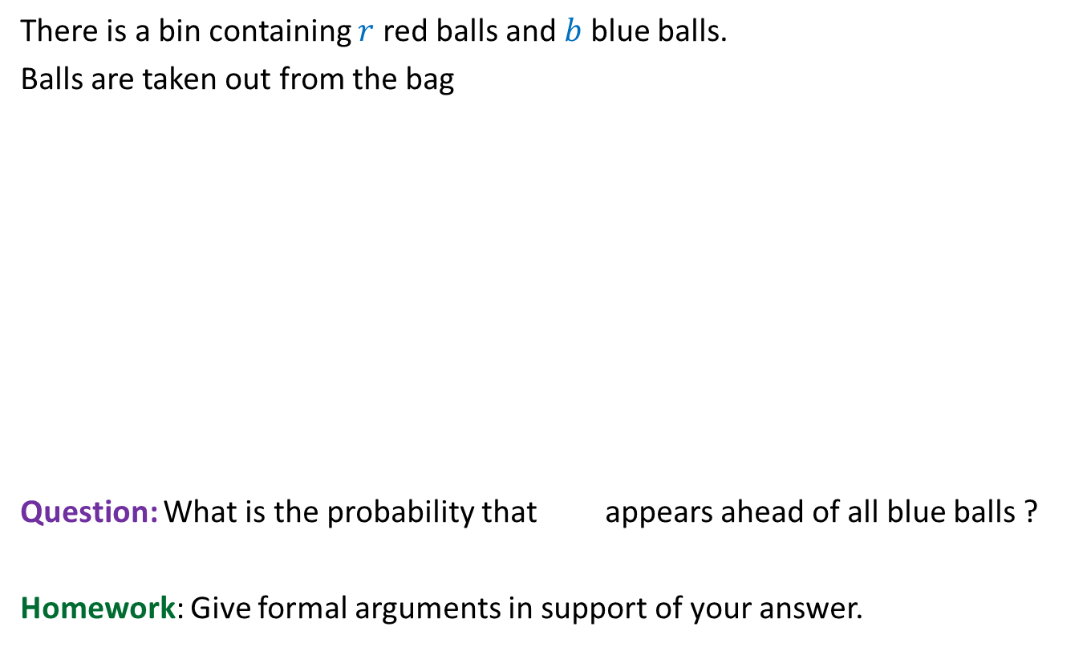
Balls Out of Bin
There is a bin containing $r$ red balls and $b$ blue balls.
Balls are taken out from the bag
Question: What is the probability that appears ahead of all blue balls ?
Homework: Give formal arguments in support of your answer.
uniformly randomly
and without replacement.
$$\frac{1}{b+1}$$

Slide 34
probability theory
Random variable
and
expected value

Slide 35

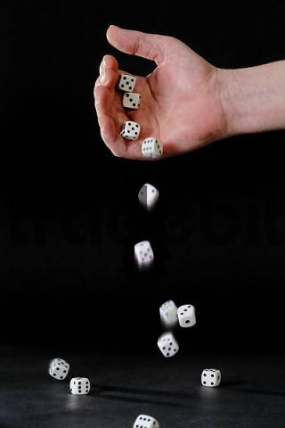
Random variable
Randomized-Quick-Sort
on array of size n
Number of HEADS in 5 tosses
Sum of numbers in 4 throws
Number of comparisons

Slide 36

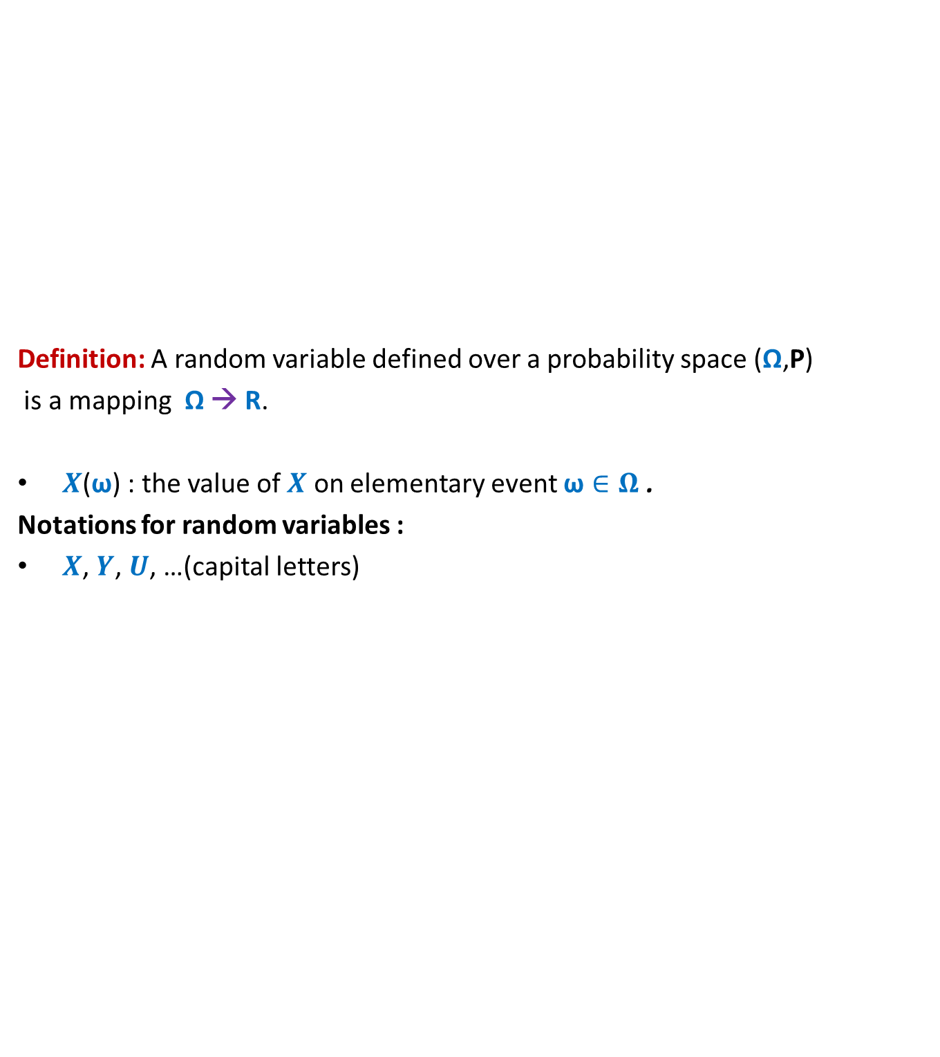
Random variable
Definition: A random variable defined over a probability space (Ω,P)
is a mapping Ω → R.
$X$($\text{ω}$) : the value of $X$ on elementary event $\text{ω}∈Ω$ .
Notations for random variables :
$X$, $Y$, $U$, …(capital letters)
$$X$$
Set of real numbers
R
Ω

Slide 37
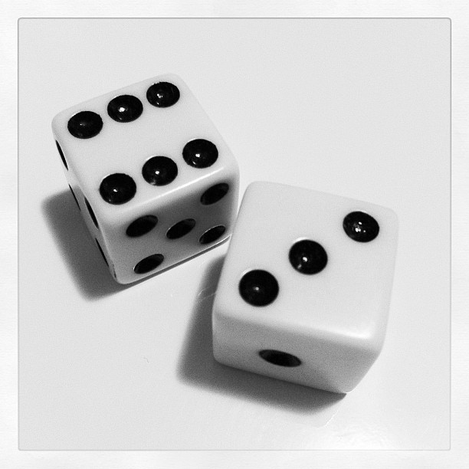
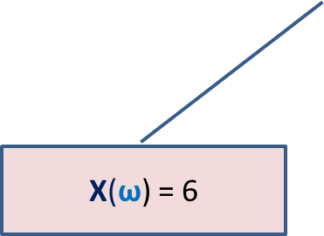
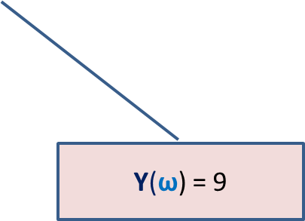

Many Random Variables for the same Probability space
Random Experiment: Throwing a dice two times
X : the largest number seen
Y : sum of the two numbers seen
X($\text{ω}$) = 6
$$\text{ω}$$
Y($\text{ω}$) = 9

Slide 38
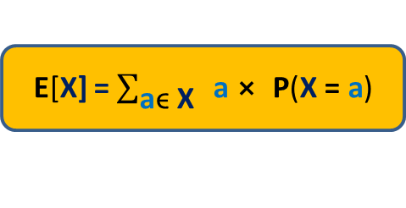

Expected Value of a random variable (average value)
Definition: Expected value of a random variable X defined over a probability space (Ω,P) is
E[X] = $\sum_{\text{ω}\text{ϵ} \text{Ω}}{\text{X}\text{(}\text{ω}\text{)}⨯ \text{P}\text{(}\text{ω}\text{)}}$
X= c
Ω
X= a
X= b
E[X] = $\sum_{\text{a}\text{ϵ} \text{X}}{ \text{a}⨯ \text{P}\text{(}\text{X}\text{ = }\text{a}\text{)}}$

Slide 39
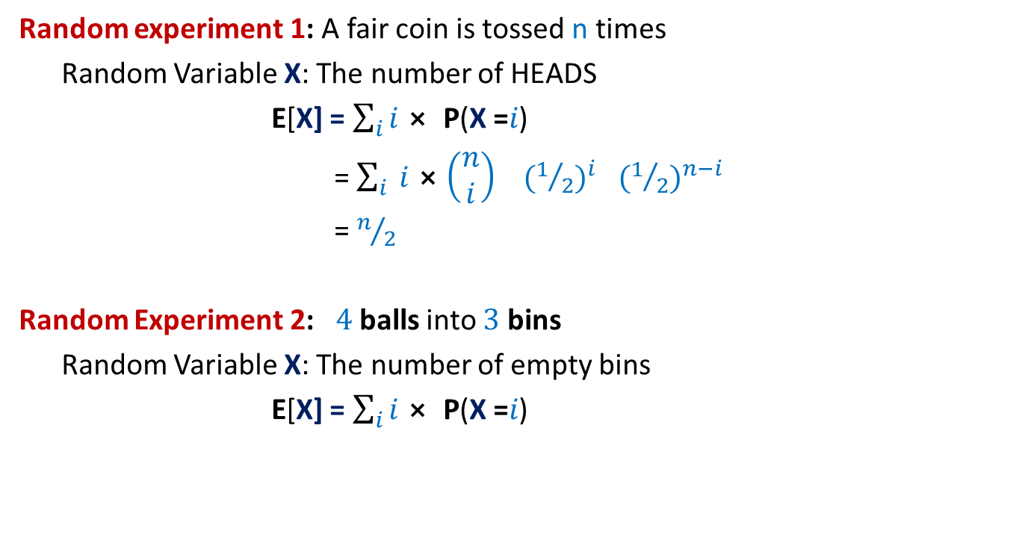
Examples
Random experiment 1: A fair coin is tossed n times
Random Variable X: The number of HEADS
E[X] = $\sum_{i}{i⨯ \text{P}\text{(}\text{X}\text{ =}i\text{)}}$
= $\sum_{i}{ i⨯\left(\begin{matrix}n \\ i\end{matrix}\right)}{ (1/2)}^{i}{ (1/2)}^{n−i}$
= $n/2$
Random Experiment 2: $4$balls into $3$ bins
Random Variable X: The number of empty bins
E[X] = $\sum_{i}{i⨯ \text{P}\text{(}\text{X}\text{ =}i\text{)}}$

Slide 40
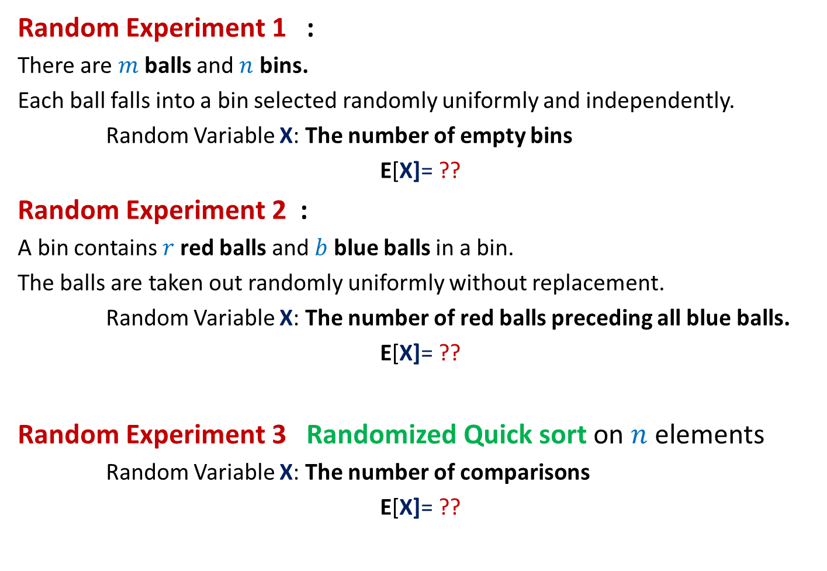
Can we solve these problems ?
Random Experiment 1 :
There are $m$balls and $n$ bins.
Each ball falls into a bin selected randomly uniformly and independently.
Random Variable X: The number of empty bins
E[X]= ??
Random Experiment 2 :
A bin contains $r$red balls and $b$ blue balls in a bin.
The balls are taken out randomly uniformly without replacement.
Random Variable X: The number of red balls preceding all blue balls.
E[X]= ??
Random Experiment 3 Randomized Quick sort on $n$ elements
Random Variable X: The number of comparisons
E[X]= ??

Slide 41
Spend at least 2 hours today trying to solve the 3 problems given in the previous slide.
These 2 hours will be very valuable for you in the long run.
I really mean it.

Slide 47
Fun with probability

Slide 48



Stick problem
We break the stick at $n$ points selected randomly uniformly.
What is the probability that the $n+1$ pieces can be joined to form a polygon ?

